Slide 1
Europe Does Not Need Any Russian Gas – New Supplies Of Piped Natural Gas & Global LNG Supplies More Than Sufficient
Facts and Figures About Europe’s Split from Russian Natural Gas – and Putin’s Overplayed Hand
October 2022
Yale Chief Executive Leadership Institute
Jeffrey Sonnenfeld

Slide 2
The European Natural Gas “Crisis” - Table of Contents
1 | Alternative Supplies of Global Natural Gas and LNG Can Replace Russian Gas
2 | Impact on the European Economy of Europe’s Split from Russian Natural Gas
3 | Impact on the Russian Economy of Europe’s Split from Russian Natural Gas

Slide 3
The Natural Gas “Crisis” - Table of Contents
1 | Alternative Supplies of Global Natural Gas and LNG to Replace Russian Gas
2 | Impact on the European Economy of Europe’s Split from Russian Natural Gas
3 | Impact on the Russian Economy of Europe’s Split from Russian Natural Gas

Slide 4
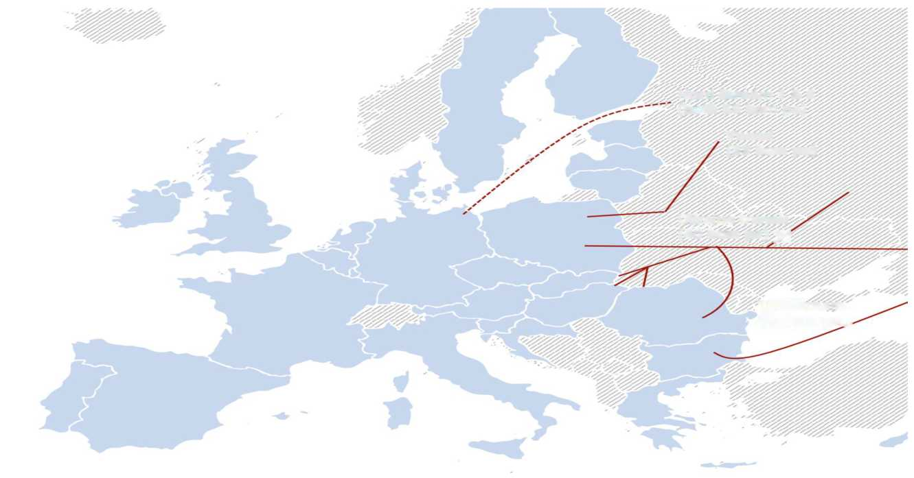
Replacing Russian Gas
With Nord Stream Already Off-Line, Europe CAN Withstand Any Further Cuts From Russia And Fully Replace Russian Gas
Amidst daily headlines of an impending “gas crisis” in Europe with the looming winter, it is important to clarify misconceptions and unjustified mass hysteria through concrete data and facts.
The alleged sabotage of the Nord Stream pipelines on 9/27 means there will likely be no Russian gas flows resuming through Nord Stream for the foreseeable future – and Putin has threatened to cut off the 40 bcm of piped Russian gas still being sent through the Ukrainian transit pipeline system.
But contrary to Putin’s fear-mongering propaganda, Europe can fully replace every last drop of lost Russian gas. While there has been a lot of focus on demand destruction, rationing, and switching away from natural gas within Europe, an examination of underlying natural gas production and trade flows reveals that actually, Europe can secure enough gas and LNG from global markets to fully substitute for Russian gas.
That enough gas exists in the global marketplace for Europe to replace Russian gas should not divert Europe from its clean energy transition. Rather, it should reassure consumers and markets that the elevated prices of the last few months reflects unjustified panic and hysteria rather than underlying supply/demand fundamentals, and there is no genuine supply crunch.
Major Pipelines Connecting Russia to Europe
(total capacity shown as bcm pa, billion cubic meters per annum)
Nord Stream 1 & 2 (both 55 bcm pa)
Yamat (33 bcm pa)
Ukraine transit (40 bcm pa)
TurkStream (32 bcm pa)
Source: Yale Chief Executive Leadership Institute

Slide 5
Replacing Russian Gas
Europe Already Largely Weaned Off Russian Gas – Down To Only 9% Dependence
Although Europe entered the year reliant on Russia for 46% of its natural gas supply, it has already reduced that dependence to ~10% in the seven months since the invasion commenced. With the Nord Stream pipeline off-line, the only remaining pipelines connecting Russia to Europe are the Ukrainian transit system – which is operating at a fraction of normal capacity and which may soon be shut down – and the Turkstream pipeline. Few expect Putin to shut down flows to the Turkstream pipeline given the dependence of countries such as Turkey and Hungary on that pipeline system.
Europe has already replaced lost Nord Stream gas with ~60 bcm of LNG and piped gas. But Europe should not fear a shut-off of the Ukrainian pipelines either – an examination of underlying natural gas production and trade data reveals that Europe can fully replace all ~100 bcm of Russian gas which would be lost from the combined shutdowns of the Nord Stream and Ukrainian pipeline systems without having to resort to demand destruction. Furthermore, Europe would be well on its way to replacing all Russian gas by the end of 2023 as new global gas supplies continue to be brought on board.
Pre-War Russian Gas Exports
Destination
(shown as % of total Russian gas exports)
Pre-War Sources of EU Gas
Imports
(shown as % of total EU gas imports)
US LNG Overtakes Russia Piped Gas in EU Gas Imports As of September 2022
(shown as % of total EU gas imports)
As of September 2022
Source: Yale Chief Executive Leadership Institute, Morgan Stanley, ING, International Energy Agency (IEA)
As of 2021
As of 2021

Slide 6
Replacing Russian Gas
Increasing Global LNG Supply Replacing Russian Gas
Global Liquefaction Plants and Export Terminals as of April 2022
Europe can replace some lost Russian gas with piped gas from neighboring producers such as Norway and Algeria, but global LNG represents the key to fully replacing Russian gas. Unlike piped gas, liquified natural gas does not require pipelines to transport. A process known as “liquefaction” turns the gas into a liquid, which can be easily shipped via ocean tankers and then “regasified” upon reaching the intended destination. Although the technology to liquify and regasify natural gas has existed for several decades, the liquified natural gas markets have only taken off over the last decade, making it a relatively new and still-growing industry. Even the United States, which is now the world’s largest exporter of LNG, did not export its first shipment of LNG until 2016 - and in fact most liquified natural gas export terminals were originally built to be import terminals, designed to help the US import natural gas from producers in the Middle East.
Although LNG is far from a panacea and should not divert Europe away from the renewable energy transition, it has an important role as a replacement to Russian piped gas.
Sources: Yale Chief Executive Leadership Institute

Slide 7
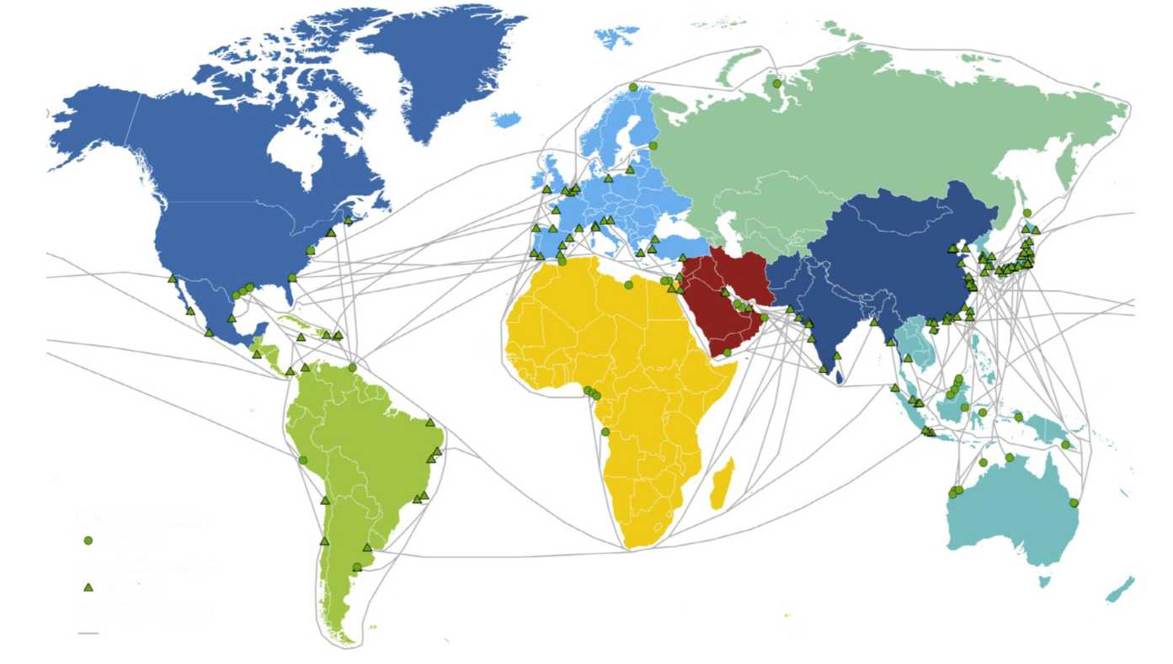
Replacing Russian Gas
LNG Shipments Are Easy To Re-Direct; Fixed Contracts Are No Obstacle
Major LNG Shipping Routes as of April 2022
Most LNG contracts are specified as “fixed-delivery”, meaning producers enter into long-term fixed-term contracts to supply set amounts of liquified natural gas. At first glance, the sheer volume of pre-contracted LNG might seem to limit the amount of LNG that makes its way to spot markets for grabs by the highest bidder – but this is not the case. Most producers retain some spare capacity to increase production beyond the volume already contracted; furthermore, gas which is already pre-contracted can be re-sold in spot markets and easily diverted to new destinations given overlapping shipping routes and tanker vessels.
While the structure of this market, due to the prevalence of fixed long-term contracts, is different than many commodities markets including more liquid piped gas markets, the availability of LNG in spot markets has thus far held up. The continued liquidity of LNG spot markets has enabled European buyers to continue on their current course: they have thus far preferred to purchase LNG at elevated rates in the spot market or in short-term contracts rather than enter into fixed long-term agreements which are generally preferred by LNG producers and exporters.
Source: Yale Chief Executive Leadership Institute
Liquefaction terminals
Operational
Regasification terminals
Operational
Main LNG trade routes

Slide 8
Replacing Russian Gas
LNG Exporters Are Globally Diversified Across Stable, Reliable Countries
Major Exporters of LNG in 2021
(units as a % share of total global LNG exports)
Unlike piped Russian gas, the largest producers and exporters of liquified natural gas are, by far and large, countries that are geopolitically aligned with Europe and stable, reliable suppliers of energy. These export numbers do not include the amount of pre-purchased LNG which has been re-sold this year by Asian countries at higher prices than what they originally paid for.
To be sure, European consumers and businesses are feeling the pain from having to pay higher prices for LNG than Russian piped gas – 10x more. But European governments have already taken concrete steps to alleviate the economic pinch, particularly with fiscal subsidies to consumers. Given the availability of global gas and LNG to fully replace Russian gas – albeit expensively – fears of people freezing in the winter or large scale shutdowns of industry are absolutely unwarranted as there is no shortage of supply – equivalent to having enough cars, but they are all Mercedes with no Kia’s available on the market.
Australia
Qatar
United States
Russia
Malaysia
Nigeria
Indonesia
Algeria
Oman
Papua New Guinea
Egypt
Sources: Yale Chief Executive Leadership Institute
Trinidad and Tobago
UAE
Brunei
Angola
Equatorial Guinea
Peru

Slide 9
Replacing Russian Gas
Almost 100 bcm Of Additional Gas Supply Brought On To Global Markets in 2022
Total Gas Production Across Major Gas and LNG Exporters
(units in bcm/year)
Global LNG markets are still growing rapidly every year. Based on forecasted production volumes for 2022 as well as projecting forward volumes that have already been exported through the first 9 months of the year, it is already readily apparent that 2022 saw significant production and export volume growth. Total additional supplies brought on to the market should approach 100 bcm by year’s end. Europe has been the ready recipient of over ~50 bcm in additional LNG already since the start of the Russian invasion of Ukraine – but even more supply is scheduled to come on board in 2023 and in years afterward, further alleviating transitory supply pressures.
Sources: Yale Chief Executive Leadership Institute
Norway
Algeria
US
Australia
Qatar
Malaysia
Nigeria
Trinidad
Indonesia

Slide 10
Replacing Russian Gas
An Additional 215 bcm In Additional LNG Capacity Already Fully Financed And Under Construction
Major Upcoming Liquefaction Projects Under Construction as of August 2022
(showing only post-FID confirmed projects only, not including pre-FID proposed projects)
In the months and years ahead, no less than ~215 bcm in additional LNG capacity will be added to global markets as additional liquefaction facilities and export terminals are completed. The list of major liquefaction projects under construction on this page shows only the projects which are already post-FID (“final investment decision”), meaning these are projects which are already largely fully financed with buyers who have already signed contracts to purchase LNG from these terminals. There are many more projects which are under development but which are still in the process of lining up fixed LNG contracts and financing, which are not included on this list – but which would further add surplus LNG capacity if brought to completion.
The ~215 bcm in capacity represented by the projects on this list would be more than sufficient to fully replace Russian piped gas and then some. In 2021, Russia exported ~150 bcm of gas to Europe.
Country | Name | Operator | Location | # Trains | Mtpa
US | Sabine Pass T6 | Cheniere | Louisiana | 1 | 4.5
US | Calcasieu Pass LNG | Venture Global | Louisiana | 10 | 10.0
Indonesia | Tangguh LNG T3 | BP | West Papua | 1 | 3.8
Mozambique | Coral South FLNG | ENI/CNPC/KOGAS | Offshore | 1 | 3.4
Mauritania | Greater Tortue FLNG 1 | BP | Offshore | 1 | 2.5
US | Fast LNG Gulf of Mexico Module 1 | New Fortress Energy | Louisiana | 1 | 1.4
US | Golden Pass T1 | QP/Exxon | Texas | 1 | 6.0
US | Plaquemines T01-02 | Venture Global | Louisiana | 2 | 1.1
US | Corpus Christi Stage 3 | Cheniere | Louisiana | 7 | 10.0
US | Plaquemines T03-10 | Venture Global | Louisiana | 8 | 4.4
Mexico | Energia Costa Azul LNG T1 | Sempra | Baja California | 1 | 3.3
US | Golden Pass T2 | QP/Exxon | Texas | 1 | 6.0
Canada | LNG Canada T1 | Shell/Petronas/PetroChina/Mitsubishi/KOGAS | British Columbia | 1 | 7.0
Qatar | North Field East T1 | QP | Ras Laffan | 1 | 8.0
Nigeria | Nigeria LNG T7 | NNPC/SHELL/TOTAL/Eni | Nigeria | 1 | 8.0
Qatar | North Field East T2 | QP | Ras Laffan | 1 | 8.0
Australia | Pluto LNG T2 | Woodside | Pluto | 1 | 5.0
US | Plaquemines T11-18 | Venture Global | Louisiana | 8 | 4.4
Canada | LNG Canada T2 | Shell/Petronas/PetroChina/Mitsubishi/KOGAS | British Columbia | 1 | 7.0
US | Golden Pass T3 | QP/Exxon | Texas | 1 | 6.0
Qatar | North Field East T3 | QP | Ras Laffan | 1 | 8.0
Mozambique | Mozambique LNG T1 (Area 1) | Total | Cabo Delgado | 1 | 6.4
Qatar | North Field East T4 | QP | Ras Laffan | 1 | 8.0
Qatar | North Field South T1 | QP | Ras Laffan | 1 | 8.0
Canada | Woodfibre | Pacific Energy/Enbridge | British Columbia | 1 | 2.1
Mozambique | Mozambique LNG T2 (Area 1) | Total | Cabo Delgado | 1 | 6.4
Qatar | North Field South T2 | QP | Ras Laffan | 1 | 8.0
 |  |  | Total | 57 | 156.9
Sources: Yale Chief Executive Leadership Institute
Equivalent to ~215 bcm in new capacity on top of 500 bcm of existing capacity

Slide 11
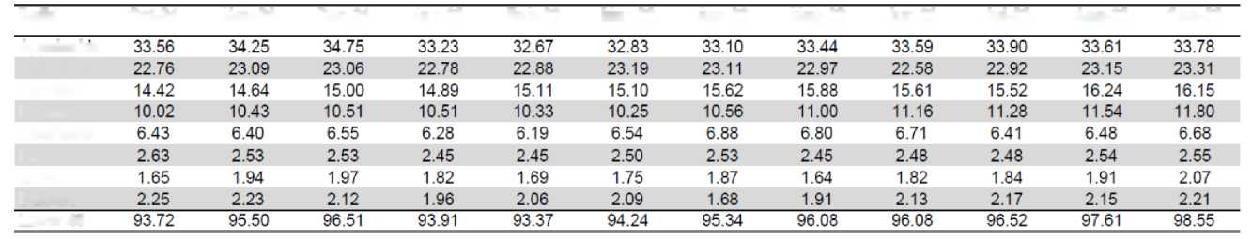
Replacing Russian Gas
US LNG Production Rapidly On The Rise
US LNG Export Terminal Capacity Additions Since 2016
(all capacity annualized; shown in mtpa, bcf, and bcm per year)
Of the additional LNG projects scheduled to be completed over the months and years ahead, a significant amount are based in the United States. This is unsurprising – from the time the US sent its first LNG export shipment in 2016, the US has quickly turned into the largest global exporter of LNG (based on 2022 volumes). US production and export volumes rose 20%+ from 2021 to 2022 alone across all major production basins and export terminals.
US policymakers are currently considering contentious proposals to reform the permitting process to expedite pipeline and terminal construction – which would further speed up the scheduled increase in LNG deliveries and further ramp up production across all fields, particularly fields in Appalachia which are currently not readily connected to export terminals via pipeline. However, policymakers must weigh difficult environmental and political tradeoffs amidst significant public controversy surrounding these proposals. Even amidst this uncertainty and irrespective of US public policy, the trajectory of continued increasing LNG supply and export capacity from the US is already clear and irreversible.
US LNG Export Terminal | Capacity in MTPA | Capacity in BCF | Capacity in BCM
2016 - Sabine Pass T1-2 | 10 | 487 | 13.8
2017 - Sabine Pass T3-4 | 10 | 487 | 13.8
2018 - Sabine Pass T5 | 5 | 243.5 | 6.9
2018 - Corpus Christi T1 | 5 | 243.5 | 6.9
2019 - Cove Point | 5.5 | 267.85 | 7.6
2019 - Freeport LNG T1 | 5 | 243.5 | 6.9
2019 - Cameron LNG T1 | 4.5 | 219.15 | 6.2
2019 - Corpus Christi T2 | 5 | 243.5 | 6.9
2020 - Elba Island | 2.5 | 121.75 | 3.4
2020 - Freeport LNG T2-3 | 10 | 487 | 13.8
2020 - Cameron LNG T2-3 | 9 | 438.3 | 12.4
2020 - Corpus Christi T3 | 5 | 243.5 | 6.9
2021 - Sabine Pass T6 | 5 | 243.5 | 6.9
2022 - Calcasieu Pass | 10 | 487 | 13.8
Total | 91.5 | 4456.1 | 126.2
Sources: Yale Chief Executive Leadership Institute
Monthly US Monthly Natural Gas Production in bcf/d
Bcf/d
Oct-21
Nov-21
Dec-21
Jan-22
Feb-22
Mar-22
Apr-22
May-22
Jun-22
Jul-22
Aug-22
Sep-22
Appalachia
Other US
Permian
Louisiana
Oklahoma
DJ
GOM
Bakken
Lower 48

Slide 12
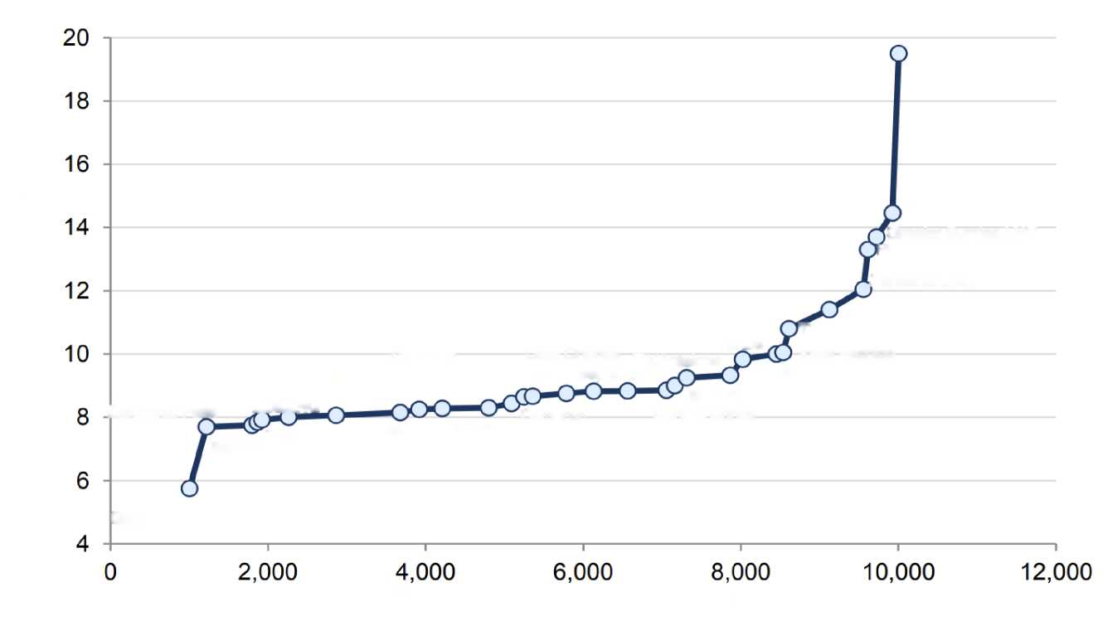
Replacing Russian Gas
Higher LNG Prices Make Increasing Numbers Of New LNG Projects Economically Viable
LNG Projects Under Development – Breakeven Cost By Individual Project
(price in $/mcf, current spot prices of ~$20-$30/mcf or higher)
Europe has struggled under the weight of higher gas prices over the last few months. While partially a reflection of elevated market hysteria, higher prices are also partially a reflection of the higher cost to liquify, ship, and then regasify LNG as opposed to cheaper piped Russian gas. Higher prices are also a reflection of the premium Europe is having to pay in spot markets to redirect contracted LNG and compete against other bidders in Asia.
However, while higher prices have created some economic hardship in Europe, the flip side is that higher prices ensure continued onboarding of new supply. Higher prices incentivize commodity producers to produce more since they are practically printing money – and make otherwise unprofitable projects with higher breakeven costs profitable. Every project under development and under consideration is currently profitable along the cost curve given elevated pricing levels.
Prelude
Commercial breakeven (US$/mcf)
Abadi LNG
Greater Sunrise LNG
Hilli Episeyo
Tanzania LNG
Prosperidade
Nigeria LNG
Tortue
Coral FLNG
Cameron
LNG
Lake Charles
Elk/Antelope
Vista Pacifico
Sources: Yale Chief Executive Leadership Institute
Golden Pass
LNG
Scarborough
Freeport LNG
Arctic LNG-2
Elba LNG
Sakhalin
Golfinho-Atum
Calcasieu Pass
Mamba
Cameron
Corpus Christi
Costa Azul
Port Arthur
Driftwood
Plaquemines
Sabine Pass
Qatar LNG Expansion
Cumulative peak production (kboe/d)

Slide 13
Replacing Russian Gas
LNG Development Breakeven Costs Are Still Coming Down As LNG Technology Matures
LNG Development Breakeven Cost – By Country
(price in $/mcf, current spot prices of ~$20-$30/mcf or higher)
LNG development breakeven costs are still coming down as LNG technology matures. The fact that LNG production has become more economical and efficient helps explain why global LNG supplies have grown so rapidly over the past few years. The wide spread between where current spot prices are – at least $20 - $30 mcf or higher – and where breakeven prices are, around $9 mcf on average – further incentivizes new LNG exploration and production since producers are reaping windfall profits. Higher profits counterintuitively generally spur further production.
To be sure, European consumers and businesses are feeling the pain from having to pay higher prices for LNG than Russian piped gas – 10x more. But European governments have already taken concrete steps to alleviate the economic pinch, particularly with fiscal subsidies to consumers. Given the availability of global gas and LNG to fully replace Russian gas – albeit expensively – fears of people freezing in the winter or large scale shutdowns of industry are absolutely unwarranted as there is no shortage of supply – equivalent to having enough cars, but they are all Mercedes with no Kia’s available on the market.
Commercial breakeven (US$/mcf)
Nigeria
Indonesia
Angola
Israel
Indonesia
Papa New Guinea
Australia
Cameroon
Mozambique
Canada
Australia
Russia
Tanzania
Tanzania
US
Russia
Yemen
Mozambique
Senegal
Canada
US
Sources: Yale Chief Executive Leadership Institute
Papua New Guinea
Nigeria
Mexico
Costs are rapidly coming down as LNG technology matures
Qatar
Cumulative peak production (kboe/d)

Slide 14
Replacing Russian Gas
Europe Remains Able And Willing To Pay More For LNG Than Asia, Guaranteeing Future Supplies
Average Cost of LNG By Delivery Region (Based on Goldman Sachs LNG Benchmarks)
(price in $/mmBtu)
There is no doubt that LNG spot prices are expensive – though European governments recognize the challenges posed to consumers and businesses and are generally engaged in fiscal transfers to help ease the pain of higher energy prices on consumers.
The challenges posed by high LNG prices cannot be diminished, but on the flip side, high prices counterintuitively guarantee continuity of supply. LNG spot prices remain 10x higher than pre-war piped gas across the board, but Europe has proven able and willing to pay a consistent premium over the benchmark Asian JKM LNG benchmark. This ensures that Europe remains the destination of choice of LNG suppliers and further eases supply pressures since shippers and producers are financially incentivized to redirect LNG supplies to Europe whenever possible.
Futures markets are pricing in a clear and consistent premium across the forward curve; partially a reflection of Europe’s hesitance to enter into long-term LNG contracts and insistence on purchases in the spot markets or in short-term contracts.
Europe
Asia
Sources: Yale Chief Executive Leadership Institute
Oct-22
Nov-22
Dec-22
Jan-23
Feb-23
Mar-23
Apr-23
Jun-23
Jul-23
Sep-23
Oct-23
Dec-22
Aug-23
Sep-23
Nov-23
Dec-23
Sep-22
Dec-22
May-23

Slide 15
Replacing Russian Gas
High Gas Prices Across The Futures Curve Incentivizes More Supply From Gas Producers
European TTF and Asian JKM Gas Benchmarks Compared to US LNG Export Costs
(price in $/mmBtu)
Futures markets across both the European TTF gas benchmark and the Asian JKM gas benchmark show gas prices are expected to come down over time – a relief to European businesses and consumers – but simultaneously future prices are still profitable enough to incentivize suppliers to produce more, since future prices remain far above breakeven physical production costs as well as breakeven costs including shipping and transportation.
TTF
US var cost to Europe
JKM
US var cost to Asia
US all-in cost to Asia
US all-in cost to Europe
Futures across both the European TTF gas benchmark and the Asian JKM gas benchmark show gas prices will come down, but still profitable enough for suppliers to produce more
Sources: Yale Chief Executive Leadership Institute
Jan-23
Mar-23
Nov-23
Jul-24
Jan-25
Jul-25
Nov-23
Sep-24
Jan-24
Sep-22
Nov-22
May-23
Jul-23
Sep-23
Nov-23
Jan-24
Mar-24
May-24
Nov-24
Mar-25
May-25
Sep-25

Slide 16
Replacing Russian Gas
No Shortage Of Major Upcoming LNG And Gas Projects Under Development Across The World
Major Upcoming Gas and LNG Projects Under Development
(as of September 2022)
In addition to liquefaction terminals coming on board – which is the primary constraint to shipping more LNG gas – there are several major gas projects currently under development across the world. The discovery of sizable new gas reserves and the development of new productive gas fields ensures that future supply of gas will continue to increase.
Prior to the commercialization of LNG markets, gas was – and in some ways still remains – a highly localized market whose primary constraint is physical delivery. Thus, as LNG infrastructure continues to be built out, gas supplies should become increasingly well distributed across the world, alleviating inequality and geographic disparity in pricing.
The new gas development projects shown on this map do not even include potential expansion or continuity of existing gas fields – such as, very prominently, the Groningen gas field in the Netherlands which is scheduled to be shut down by 2024 despite retaining significant gas reserves.
Gas
LNG
Unconventional Gas
Sources: Yale Chief Executive Leadership Institute

Slide 17
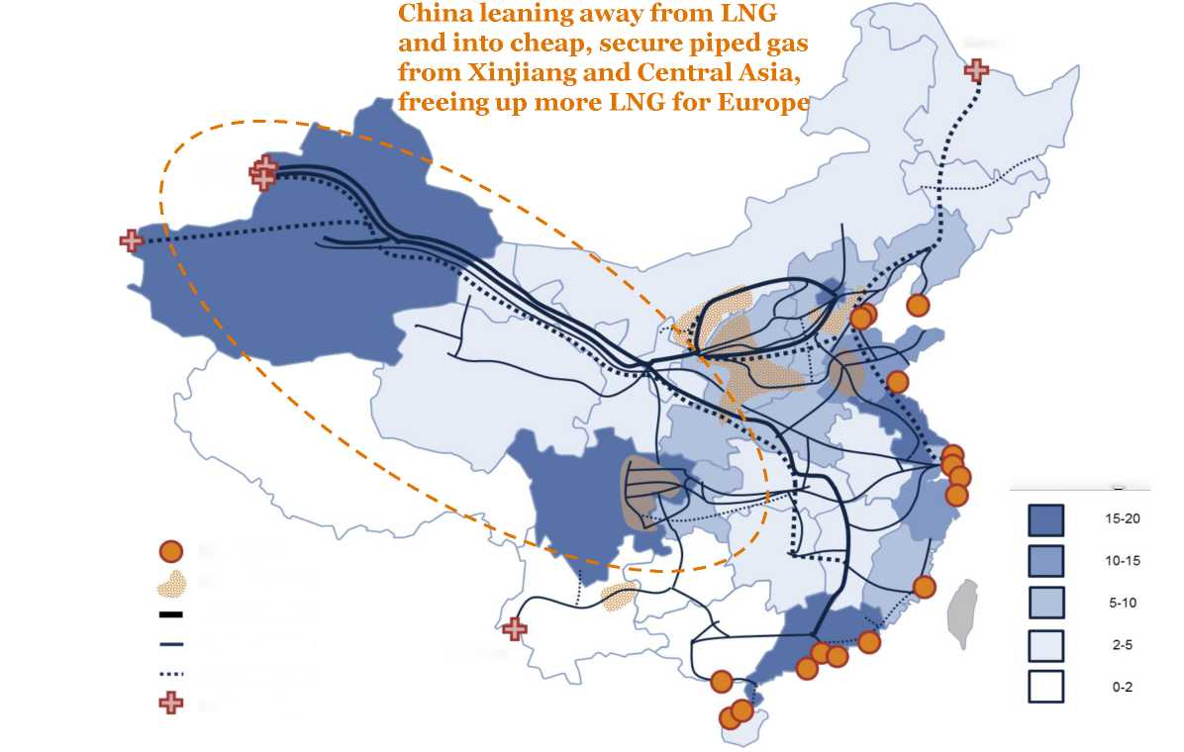
Replacing Russian Gas
China Moving Away From Global LNG And Towards Secure Domestic Piped Gas From Xinjiang And Central Asia
LNG Import Terminals, Domestic Liquefaction Plants and Major Gas Pipelines in China
(as of 2022)
Europe has also benefitted from decreased LNG demand from Asia, most prominently from China. While partially a reflection of the Chinese economic slowdown this year and partially a reflection of increased Chinese reliance on coal and alternative energy sources this year, China stands to buy significantly less LNG from global markets moving forward since China is focused on securing cheap piped gas from domestic sources in Xinjiang as well as from Central Asian countries. The build-out of piped gas infrastructure through pipelines and upstream technology was a central piece of China’s One Belt One Road investments across Central Asia, and China generally prefers to diversify its energy sourcing so as to not be completely reliant on the whims of global LNG market pricing or geopolitical competitors.
China’s structural move away from global LNG reliance and towards more domestic production and piped gas from Central Asia will continue to free up supplies in the LNG market moving forward, loosening up market tightness and ensuring more LNG will make its way to Europe in the years ahead.
China leaning away from LNG and into cheap, secure piped gas from Xinjiang and Central Asia, freeing up more LNG for Europe
Russia
Central Asia
Sources: Yale Chief Executive Leadership Institute
Annual demand - Bcm
LNG terminal
Domestic LNG hub
Pipelines > 20Bcm
Pipelines < 20Bcm
Myanmar
Under construction
Border crossing

Slide 18
Replacing Russian Gas
Additional Regasification Projects Are Coming Online In Europe Rapidly
New Regasification Projects Commissioned in Europe After the Russian Invasion of Ukraine
(all capacity annualized; shown in mtpa per year; first FSRUs slated to open by winter 2022/spring 2023)
In addition to sourcing and securing global LNG supplies, another challenge facing Europe has been a shortage of LNG regasification and pipeline delivery infrastructure in order to move gas around the continent.
In the months after the Russian invasion of Ukraine, the governments of Europe – particularly of Germany – have moved expeditiously to develop new regasification projects, including many FSRUs (floating storage regasification units) which can be brought onboard relatively quickly within a span of months. In fact, all the new regasification projects commissioned in Europe – the first of which are scheduled to open by winter 2022/spring 2023 – will bring on board ~100 bcm additional regasification capacity in addition to Europe’s existing capacity of ~150 bcm, significantly increasing European capability to receive LNG supplies.
Country | Facility | Type | Capacity (mtpa)
Belgium | Zeebrugge (Expansion) | Onshore | 6
Germany | Lubmin | FSRU | 3.6
Germany | Wilhelmshaven | FSRU | 3.6
Germany | Brunsbuttel | FSRU | 3.6
Germany | Stade | FSRU | 3.6
Germany | Lubmin 2 | FSRU | 3.6
Germany | Brunsbuttel 2 | Onshore | 5.8
Germany | Stade 2 | Onshore | 9.6
France | Le Havre | FSRU | 3.6
Netherlands | Eemshaven | FSRU | 5.8
Cyprus | Floating | FSRU | 1.5
Finland/Estonia | Floating | FSRU | 3.6
Greece | Alexandroupolis | Onshore | 4
Italy | Central | FSRU | 3.6
Italy | Sardinia | FSRU | 5.8
Poland | Swinoujscie | Onshore | 2.4
Total |  |  | 69.7
Sources: Yale Chief Executive Leadership Institute
equivalent to ~100 bcm more in European regasification capacity in addition to existing capacity of ~150 bcm

Slide 19
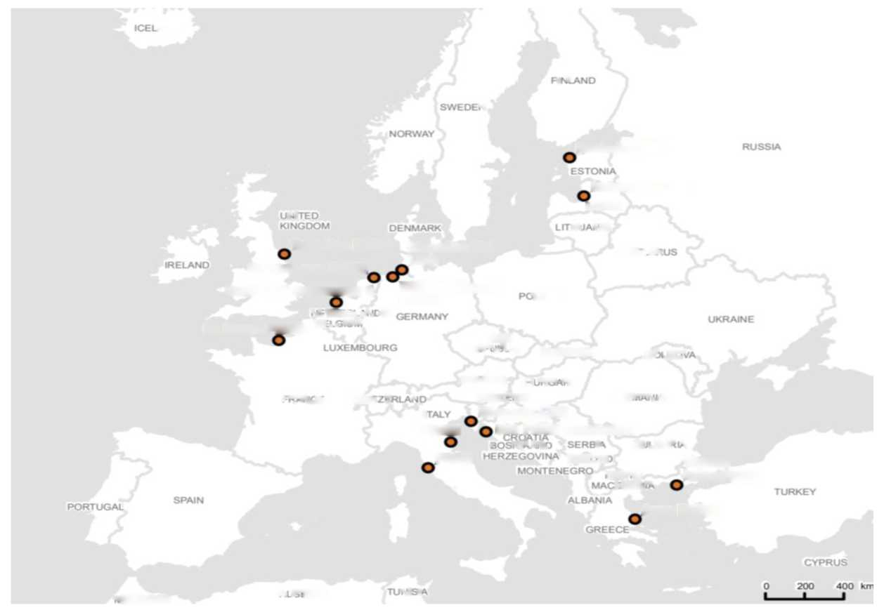
Replacing Russian Gas
New Regasification Terminals And Expansion Of Mothballed Terminals Across Europe
ICELAND
As shown by the map to the right, the regasification terminals under development are geographically well distributed. This does not even include the potential development of any pipeline infrastructure to better connect the Iberian peninsula, which has surplus regasification capacity with mothballed regasification plants making up 40% of the EU’s total existing regasification capacity, with gas-starved Central Europe, which would further guarantee access to gas and help narrow geographic disparities in the distribution of gas within Europe.
FINLAND
SWEDEN
NORWAY
RUSSIA
Paldiski LNG
ESTONIA
Incukalns LNG
UNITED KINGDOM
LATVIA
Teesside FSRU
DENMARK
LITHUANIA
Brunsbuettel LNG
BELARUS
IRELAND
Eemshaven FSRU
Gate LNG expansion 2
Wilhelmshaven FSRU
POLAND
Le Havre FSRU
NETHERLANDS BELGIUM
GERMANY
UKRAINE
LUXEMBOURG
CZECH REPUBLIC
SLOVAKIA
MOLDOVA
Sources: Yale Chief Executive Leadership Institute
AUSTRIA
HUNGARY
FRANCE
SWITZERLAND
SLOVENIA
ROMANIA
ITALY
Slovenia LNG
FSRU
Krk FSRU expansion
CROATIA BOSNIAAND HERZEGOVINA
SERBIA
BULGARIA
FSRU
KOSOVO
Thrace
INGS FSRU
montenegro
NORTH MACEDONIA
SPAIN
albania
Argo FSRU
TURKEY
greece
CYPRUS
MOROCCO
ALGERIA
TUNISIA

Slide 20
Replacing Russian Gas
2022 Would Have Had Even More LNG Supply Were It Not For Idiosyncratic Disruptions To Certain Liquefaction Terminals
Known Liquefaction Terminal Disruptions in 2022
(all capacity annualized; shown in mtpa per year; first FSRUs slated to open by winter 2022/spring 2023)
Even though 2022 is expected to see ~100 bcm in additional LNG supplies brought onto the market, it is important to note that the additional supply brought on board would have been considerably more were it not for an unusual number of idiosyncratic disruptions to key liquefaction terminals, most prominently the Freeport LNG terminal in the United States in summer 2022 which took offline 15 bcm in export capacity.
All of these idiosyncratic disruptions are in the process of being resolved with capacity fully restored. Once this spare capacity is brought online, global LNG supplies will increase even more, further alleviating transitory market tightness.
Facility | Impact (mtpa) | Start | End | Outage Reason
US (Freeport) | 15.0 | June 8, 2022 | TBD | major explosion
Australia (Prelude) | 3.6 | July 7, 2022 | August 18, 2022 | labor strike
Nigeria | 4.0 | Summer 2022 | TBD | upstream issue
Trinidad | 3.0 | Late 2020 | TBD | feedgas issue
Australia (Ichthys) | 8.9 | July 1, 2022 | August 5, 2022 | maintenance
Peru | 4.5 | July 1, 2022 | July 31, 2022 | maintenance
Australia (APLNG) | 4.3 | July 28, 2022 | August 26, 2022 | maintenance
Egypt (Damietta) | 4.9 | August 2022 | August 2022 | maintenance
Australia (APLNG 2) | 2.3 | September 2022 | TBD | maintenance
Total Disrupted Supply | 50.5
equivalent to 70 bcm of spare capacity
2022 would have had even more global LNG supply if not for one-off idiosyncratic disruptions such as Freeport explosion – all of which will soon be resolved and capacity fully restored
Sources: Yale Chief Executive Leadership Institute

Slide 21
The European Natural Gas “Crisis” - Table of Contents
1 | Alternative Supplies of Global Natural Gas and LNG Can Replace Russian Gas
2 | Impact on the European Economy of Europe’s Split from Russian Natural Gas
3 | Impact on the Russian Economy of Europe’s Split from Russian Natural Gas

Slide 22
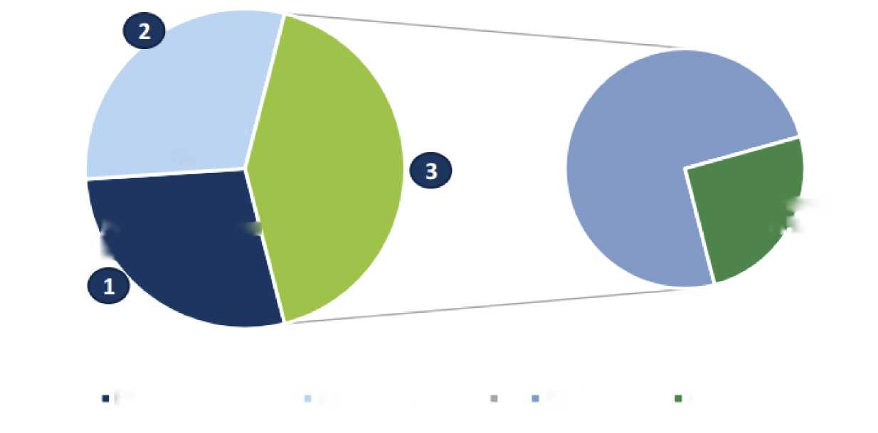
European Economic Impact
Even Higher Prices Will Not Spur Large-Scale Industrial Demand Destruction
There is no doubt that European businesses and consumers are feeling the pain from higher gas prices. European governments have already announced massive fiscal subsidies and transfer payments to ease economic pressures on consumers across the income spectrum, and clearly governments are giving priority to helping consumers.
The impact of replacing Russian gas on European businesses is less well understood, with less proactive policy from European governments. But speculation that there will need to be large-scale industrial demand destruction are unfounded as we show in the subsequent slides. European businesses make up 30% of total EU natural gas demand; power generation makes up 28% while building heating across residential and commercial buildings makes up the remaining 42%.
EU27 + UK Natural Gas Demand by Sector
(%, as of 2020)
European natural gas demand stems from three key groups – industry, power generations, and building heating
Residential 31%
Industry & other 30%
Other 42%
Commercial 11%
Power generation
28%
Sources: Yale Chief Executive Leadership Institute
Power generation
Industry & other
Residential
Commercial

Slide 23
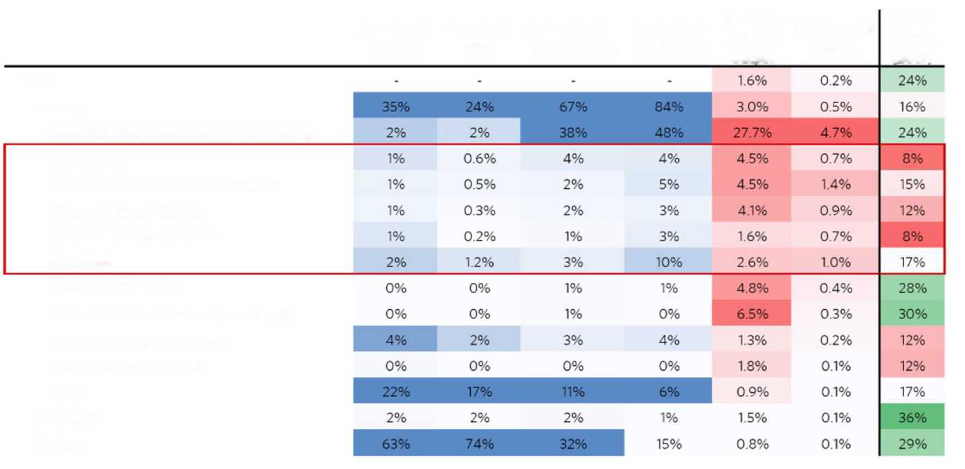
European Economic Impact
The Most Energy-Intensive Industries In Europe Contribute Relatively Little To The European Economy
The impact of higher energy prices across most of European industry is considerably less than generally recognized. The most natural-gas intensive industries are five sectors – metals, chemicals, paper, coke, and refined petroleum and other minerals processing – which account for a whopping 25% of the region’s natural gas usage but a minimal 3% of the total gross value added in Europe. In fact, these impacted industries are already some of the lowest-margin industries in Europe and have been facing net outflows to countries with cheaper wages, cheaper energy, and less environmental restrictions even prior to the invasion. As Europe strives to adapt its economy into the 21st century through digital and technological transformation and through leadership in renewable energy, these industries were already on the wrong side of secular trends for years, and their overall contribution to the European economy is minimal.
Consumption of Natural Gas and Electricity by Industry
Industry % Output
Industry % GVA
Sector % of Ind Electricity Use
Sector % of Ind NG Use
Electricity Spend % Output
NG Spend % Output
Pre-Tax Margin (2019)
Total
Industry
Electricity, Gas, Steam, and Air Conditioning
Basic Metals
Other Non-Metallic Minerals Products
Paper and Paper Products
Coke and Refined Petroleum
Chemicals
Mining and Quarrying
Sources: Yale Chief Executive Leadership Institute
Water Collection. Treatment, and Supply
Food, Beverages, and Tobacco
Wood and Wood Products
Other
Agriculture
Services

Slide 24
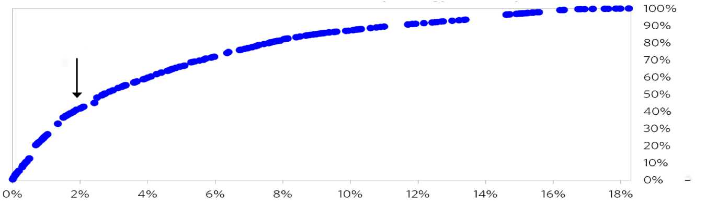
European Economic Impact
10% Of All European Industry Accounts for Half Of Industrial Energy Use – Despite Contributing Only 2% To The European Economy And Employing Few European Workers
Measured another way, about 10% of all European industry accounts for almost half of industrial energy spending, and these industries contribute about 2% to Europe’s gross value added.
Furthermore, from an employment lens, these companies are relatively minor employers meaning very few jobs are at risk of being lost. Even the largest employer of the five most energy intensive industries, chemicals, only employs ~1 million workers across all of Europe. Most of the energy intensive industries such as fertilizers, glass, and cement employ ~100,000 workers in aggregate, or less than 0.03% of the total European workforce added together. Thus, while these energy intensive industries are not favored under a regimen of structurally higher energy prices, the economic fallout is relatively minimal given the very minor employment footprint and gross value added by these industries.
Consumption of Natural Gas and Electricity by Industry
About 10% of all industry accounts for almost half of industrial energy spending
Share of Industrial Energy Consumption
Share of GVA
Sources: Yale Chief Executive Leadership Institute
Total Workers At Risk In Europe From Potential Loss of Energy-Intensive Industries
Energy Intensive Industry | Total Employees (millions) | % of European Workforce
Chemicals | 1.2 | 0.55%
Cement | 0.04 | 0.02%
Pulp & Paper | 0.18 | 0.08%
Glass | 0.1 | 0.05%
Metals & Mining | 0.29 | 0.13%
Clay | 0.2 | 0.09%
Fertilizers | 0.08 | 0.03%

Slide 25
European Economic Impact
Even The Most Energy Intensive Industries In Europe Are Reliant On Diversified Energy Sources Including Renewables And Oil
Although there is no disputing that energy intensive industries will be adversely affected by structurally higher energy prices in Europe, even the most energy-intensive industries such as chemicals are not solely reliant on natural gas. A breakdown of total energy consumption by the EU27 chemicals industry reveals that prior to the invasion, gas made up 35.6% of total energy consumption – no doubt a significant amount but hardly a single-energy source dependence. Gas to oil and gas to renewables substitution will certainly provide some replacement for European industry, so it is misleading to think that the European chemical industry will have to shut down altogether with no recourse or alternative.
Total Energy Consumption in EU27 Chemicals Industry By Source
(as of 2019 per Eurostat)
Sources: Yale Chief Executive Leadership Institute

Slide 26
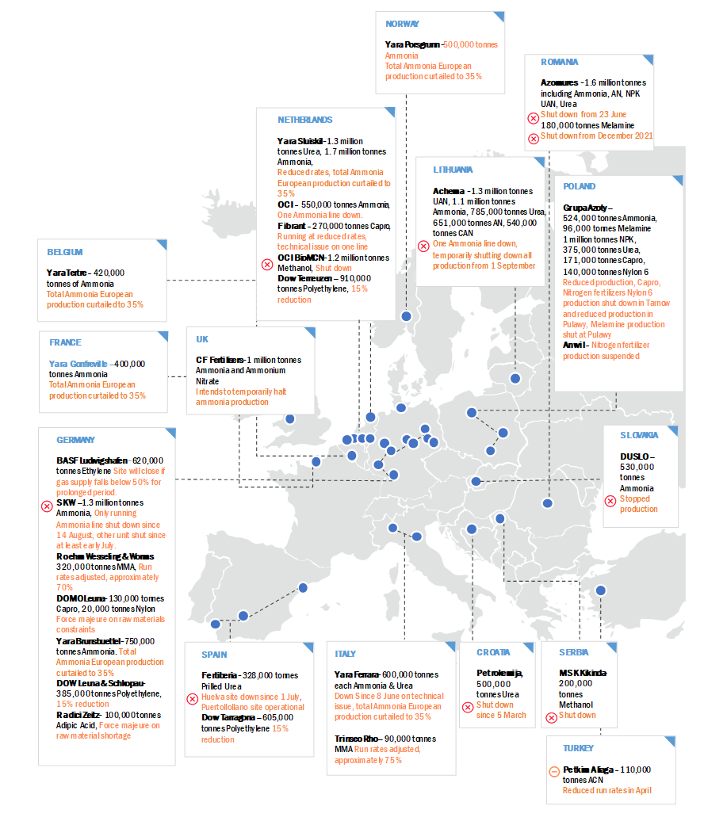
European Economic Impact
NORWAY
Yara Poesghurn-50 0,000 tonnes
Ammonia
Total Ammonia European an
production curtailed to 35%
ROMA MA
Azomuress -1.6 milliontonnes including Ammonia, AN. NPK UAN, Urea
NETHERLANDS
Shutdown from 23 June 180.000tonnes Melamine
Yara Sluiskil -1.3 million
tonnes Ure a, 1.7 million tonnes Ammonia,
Shut downfrom December 2021
Reducedrates, total Ammonia European production curtailed to
3 5%
LITHUANIA
Achema -1.3 million tonnes
UAN, 1.1 million tonnes
Ammonia, 785,000tonnes Urea, 651,000 tonnes AN, 540 ,000 tonnes CAN
POLANO
OCI- 550,0 00 tonnes Ammonia
One Ammonia line down.
GrupaAzoby-
52 4,000 tonnes Ammonia,
9 6,0 00 tomes Melamine
1 million tonnes NPK,
375, 000 tonnes Urea,
171, 00 0tonnes Capro,
140,000 tonnes Nylon 6
Reduced production, Capro, Nitrogen fertilizers Nylon 6 production shut down in Tarnow and reduced production in
Pulawy, Melamine production shut at Pulawy
Anwil- Nitrogenfertilizer production suspended
Fibtrant-270,000 tonnes Capro
Running at reduced rates, technical issue on one line
A breakdown of production shutdowns across Europe in the most energy-intensive industries since the war broke out reveals that production shutdowns have hardly taken place to the extent estimated by many cynical analysts at the outset. In fact, our comprehensive tracking suggests that most production halts have been temporary and partial, with most shutdowns only encompassing a fraction of total activity at even the impacted facilities. These shutdowns represent a small fraction of total activity in even the most energy-intensive industries, and these businesses have largely passed on the costs from higher energy prices onto consumers across the world, not only those based in Europe. Fears of large-scale industrial shutdowns across Europe have been overblown from the outset and have not played out in the 7 months since the invasion began.
BELGIUM
One Ammonia linedown, temporarily shutting down all production from 1 September
BEL GILM
YaraTertre- 420,000 tonnes of Ammonia
Total Ammonia Europe an production curtailed to 35%
OCI BioMCN-1.2 milliontonnes Methanol, shut down
Dow Temeuzen - 91 0,000
tonnes Polyethylene, 15%
reduction
FRANCE
UK
Yara Gonfreville -400,000 tonnes Ammonia
Total Ammonia European production curtailed to 3 5%
CF Ferti lisers-1 million tonnes Ammonia and Ammonium Nitrate
Intends to temporarily halt ammonia production
GERMANY
SLOVAKIA
BASF Ludvigshafen-62 0,00 0
tonnes Ethy le ne Site will close if gas supply falls below 50% for
prolonged period.
DUSL.O-530,000 tonnes Ammonia
SKW-1.3 milliontonnes
Ammonia, Only running
Ammonia line shut down since 14 August, other unit shut since at least early July.
Stopped production
Roehm Wesseling &Worms
320 .000 tonnes MMA Run rates adjusted, approximately 70%
Sources: Yale Chief Executive Leadership Institute
DOMOLeuna- 130,000 tomes Capro, 20,000 tonnes Nylon
Force majeure on raw materials constraints
Yara Brunsbuetiel- 750,000 tonnes Ammonia. Total Ammonia European production curtailed to 35%
SPAIN
ITALY
CROATIA
SERBIA
DOW Leuna & Schlopau-385,000 tonnes Poly et hylene,
15% reduction
Fertiberie - 328,000 tomes Prilled Urea
Yara Ferrara- 600,000 tonnes each Ammonia & Urea
Petrolemija, 500,000
tonnes Ure a
MSKKkinda
200,000
tonnes Methanol
Huelv a site down since 1 July, Puertollollano site operational
Down Since8 June ontechnical issue, total Ammonia European production curtailed to 35%
Shutdown since 5 March
Radiei Zeilz- 100,000 tonnes Adipic Acid, Force majeure on raw mate ria I shortage
Dow Tarragpna — 605,000 tonnes Polyethylene 15% reduction
Shut down
Trinseo Rho— 90,000 tonnes MMA Run rates adjusted, approximately 75%
TURKEY
Pe tkim A liaga - 110,000 tonnes ACN
Reduced run rates in April

Slide 27
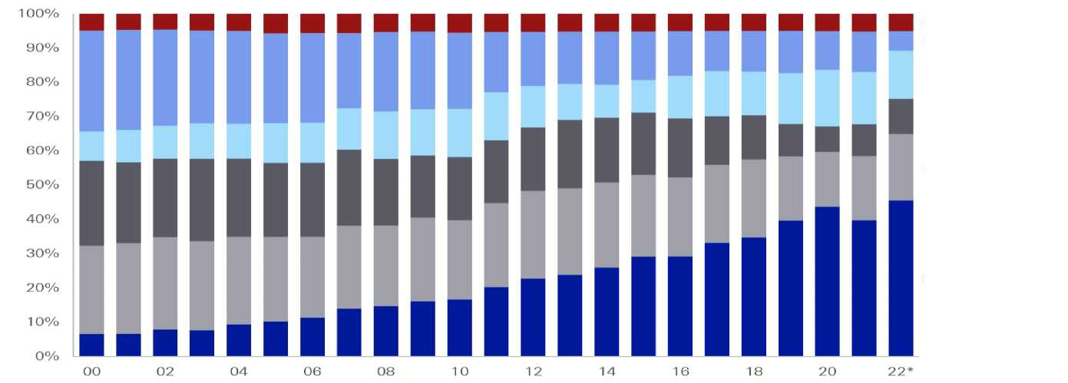
European Economic Impact
Even Germany Well On Its Way To Replacing Russian Natural Gas
Even Germany – which faces some of the hardest energy challenges within the EU – is well on its way to replacing Russian gas, with Chancellor Olaf Scholz pledging zero Russian gas dependence by the end of 2023 in September 2022. Gas actually makes up a relatively insignificant and still-diminishing share of total electricity production sourcing in Germany, with renewables the largest share by far at over 40%+ - a trend which will only amplify in the years ahead. Furthermore, even when looking beyond electricity generation and towards Germany’s primary energy consumption, gas at 27% comes in well behind oil at 34%. This mix will continue to evolve in the years ahead as renewables scales up. And the impact is hardly evenly distributed across German society, since of that 27% gas usage, most comes from energy intensive industries in the Ruhr corridor which, as discussed previously, actually contribute minimal gross value added and employment to the overall European economy. While the challenges faced by the European economy from structurally higher energy prices are genuine and profound, it is important not to overstate the magnitude and impact of these challenges – which should be relatively minimal and contained through savvy government fiscal transfers to help consumers.
Sources of Electricity Production in Germany
(shown over time)
Other
Nuclear
Gas
Hard coal
Lignite
Renewables
Sources: Yale Chief Executive Leadership Institute
German Primary Energy Consumption
(as of 2021)
Oil
Gas
Coal
Renewables
Nuclear
Other

Slide 28
The European Natural Gas “Crisis” - Table of Contents
1 | Alternative Supplies of Global Natural Gas and LNG Can Replace Russian Gas
2 | Impact on the European Economy of Europe’s Split from Russian Natural Gas
3 | Impact on the Russian Economy of Europe’s Split from Russian Natural Gas

Slide 29
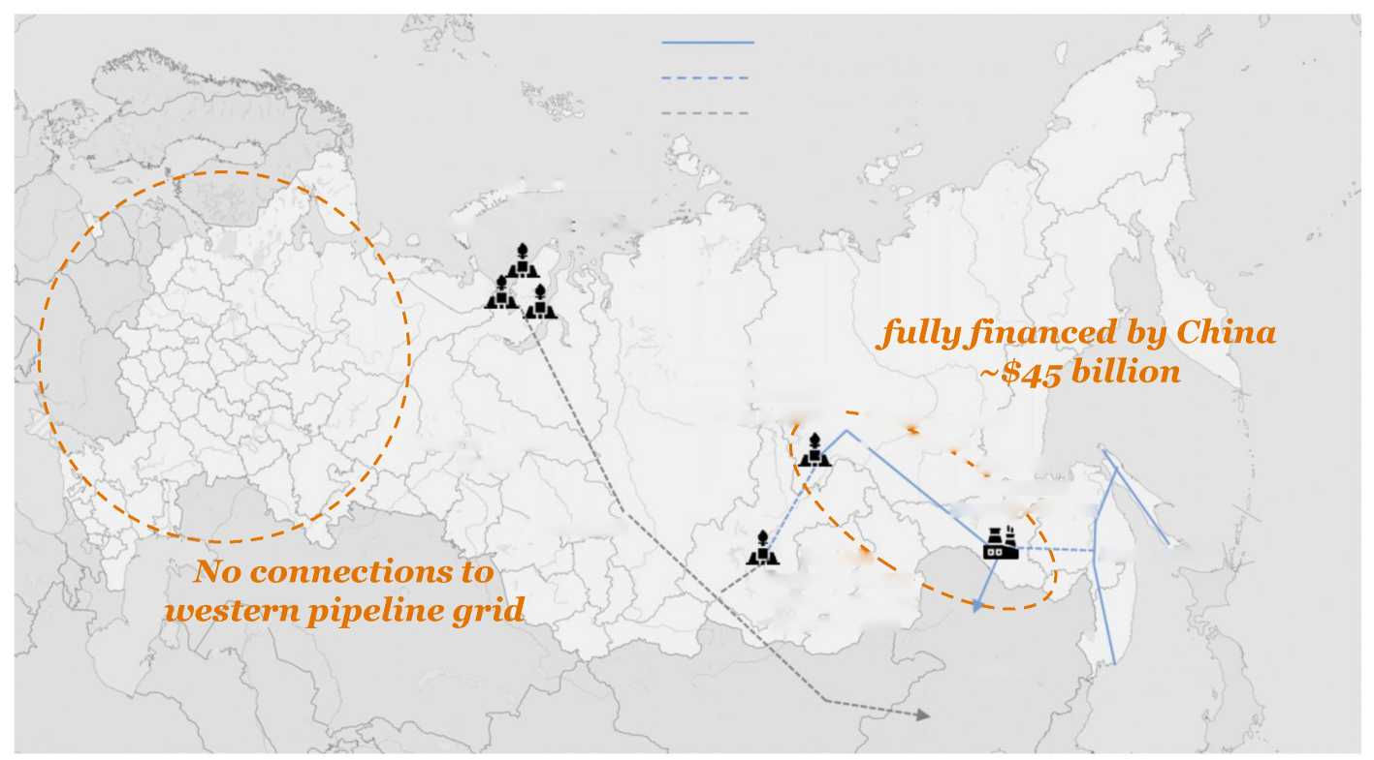
Russian Economic Impact
Gas Not Fungible; Russia’s Much-Hyped “Pivot to The East” Still Far Away From Happening
To mitigate lost European transports of gas, in a speech in the days following the invasion, Putin doubled down on a much-ballyhooed “povorot na vostok”, or “pivot to the east”, declaring “[Russia] must diversify exports. Let us assume that energy supplies to the West will continue going down in the foreseeable future. Therefore, it is important to consolidate the trend of the past few years: to redirect our exports gradually to the rapidly growing markets of the South and the East.” The vast majority of Russia’s pipelines flow towards Europe; those pipelines, which originate in western Russia, are not connectable to a separate nascent network of pipelines which link the far East of Russian Siberia to Asia. This Asian pipeline network contains a fraction of the capacity of the European pipeline network; and even long-planned Asian pipeline projects currently under construction are still years away from becoming operational, much less hastily initiated new projects.
Operating pipelines
Pipelines under construction
Perspective pipelines
Yamal cluster
Reserves and resources: 20.4 tcm Production 2020 100 bcm
fully financed by China ~$45 billion
Chayanda Reserves: 1.2 tcm Plateau production: 25 bcm in 2025
Power of Siberia-2
50 bcm
Power of Siberia 38 bcm
Sakhalin
Amur GPP
Processing capacity - 42 bcm
Krasnoyarsk
No connections to western pipeline grid
Kovykta
Khabarovsk
Reserves: 1.8 tcm Plateau production: 27 bcm in 2026
China
Vladivostok
Mongolia
Source: Yale Chief Executive Leadership Institute

Slide 30

Russian Economic Impact
Russia’s “Pivot to The East” Faces Daunting Financial, Logistical Hurdles
The 16.5 billion cubic meters of gas exported by Russia to China last year represented less than 10% of the 170 billion cubic meters of natural gas sent by Russia to the European market. Financing of these costly gas pipeline projects also now puts Russia at a significant disadvantage. The major operational pipeline linking Siberia to China, the $45 billion, thirteen-hundred mile “Power of Siberia” pipeline, was completely financed by China in 2014; now the onus is now on Russia to fund these new pipeline projects itself. In anticipation of “massive capital expenditures”, the Russian gas giant Gazprom has already taken the unprecedented step of suspending dividends, the first time in thirty years, and its stock is the single worst performing major stock on the Moscow Stock Exchange since the invasion.
Total Russian Gas Sent to Europe vs. China in 2021
(units in bcm/billion cubic meters)
Annualized Russian Government Revenue Lost from Loss of European Market
(Yale CELI estimates based on historical Gazprom data)
Russian Gas Sent to Europe
$100+ billion
Russian Gas Sent to China
Russia Will Likely Have to Pay for Pipelines Connecting to Asia By Itself
EUROPE NEWS
Source: Yale Chief Executive Leadership Institute
Gazprom shares crater after Russian energy giant cancels dividend for first time since 1998
PUBLISHED THU, JUN 30 2022-10:16 AM EDT

